Slide 1
Iteration 2 Status
1
GUI Automation using OpenCV
https://github.com/utastudents/ShapeRecipe.git
CSE-6324-001 TEAM 1
Harsh Chaludia
Deep Patel

Slide 2
STATUS SUMMARY
What new detection methods can be added ?
How many filters are to be considered?
How are we going for Mobile Design ?
EXPO – A native app platform
Android
IOS

Slide 3


PROGRESS
From last Iteration, we had the following observations.
IMPLICATIONS
MODIFICATIONS
The hardcoded shapes with MS paint were working fine , but we saw that the hand drawn sketches were breaking while decoding the shapes.
We were confused about what to incorporate, or something which is easy to make.
Also, we were missing to have an instruction manual for users to draw.
We were not sure, how to generate code for both Android/IOS with React Native.
To overcome this issue, we decided to have a filters for colored, and black & white sketch.
We now have finally decided to include numbers, and will try to get alphabets, if we can pass the initial methods of detection.
Now, we will be including a manual to draw shapes mapped to website elements.
We got to know about EXPO, and decided to use this Platform to render applications on both android and IOS platform.

Slide 4
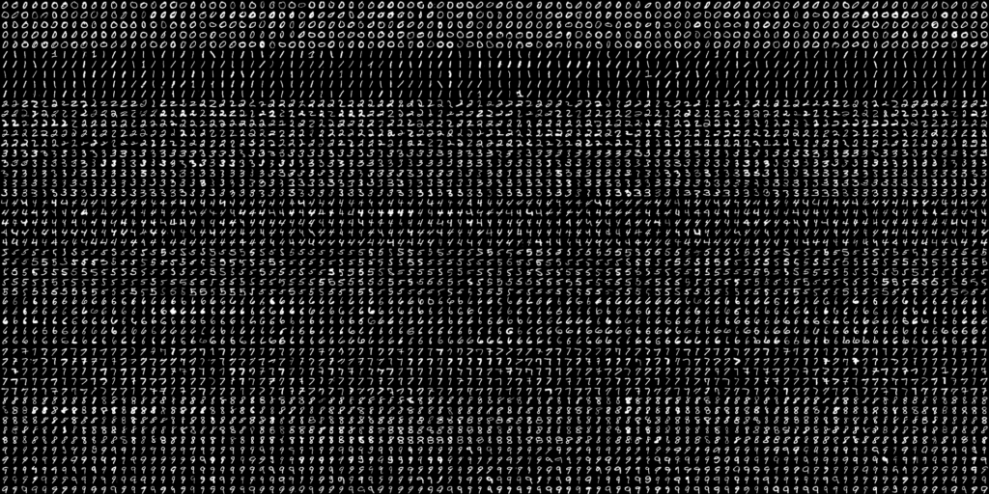
ALGORITHM
For Number Detection,
We are using OPEN CV digit dataset sample. It contains 5000 digits, 500 each for digits 0-9.
First, we will go pre-processing, next we calculate HOG (Histogram of Oriented Gradients) descriptor, and finally we train the model, followed by testing some digits to get accuracies.
Digit Dataset for OCR

Slide 5
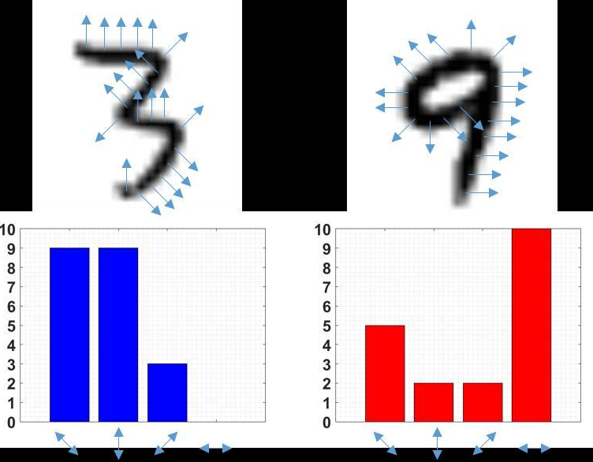


ALGORITHM
1. Deskewing [1]
2. Histogram of Oriented Gradients descriptor [2]
3. Training and testing model. [1]

Slide 6
MOBILE DESIGN
6
What will be the Strategy ?
Just as we did for website, we are going to use the output array of shapes with their colors, to map a design onto an app.
This design could be an open source theme, where the user may not just receive the skeletal design but also a good theme, to begin with.

Slide 7
EXPO
7
Why EXPO ?
Expo is an open-source platform for making universal native apps for Android, iOS, and the web with JavaScript and React.
It gives a standalone binary package for submission to IOS (xcode), and Android (android studio)
It is a set of tools and services built around React Native and native platforms that help you develop, build, deploy, and quickly iterate on iOS, Android, and web apps from the same JavaScript/TypeScript codebase.

Slide 8
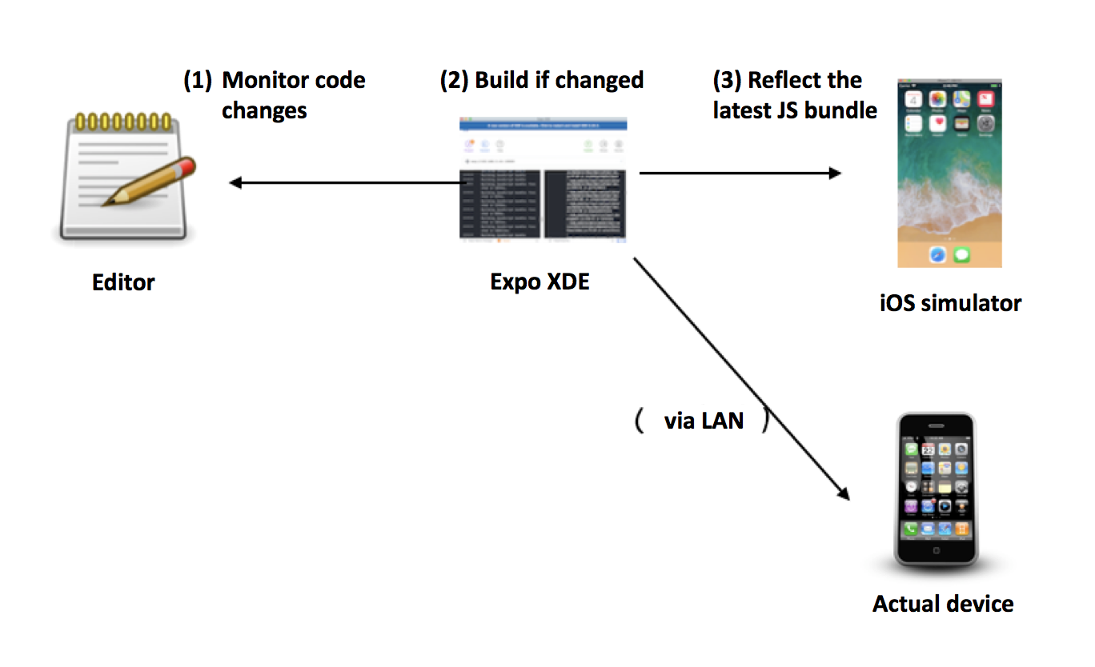
WORKING OF EXPO
8
Gives a realtime testing theme, before actually releasing on app store, and playstore [3]

Slide 9
DELIVERIES
CRITICAL DELIVERABLES
Converting Hand Drawn sketches to skeletal design for website.
Make a UI Layout to understand the functionalities properly.
More..
To include a sitemap of all the basic functionalities into one page.
Converting Colored sketches with shapes to skeletal design for website
Pass all the tests for detecting shapes.
Pass all the tests for detecting colors of shapes.

Slide 10
GOALS FOR NEXT ITERATION
DATE OF NEXT STATUS UPDATE
LIST GOALS FOR NEXT ITERATION
Complete all the tests for initial methods for detection.
Incorporate digits, and maybe try for alphabets.
Introduce a filter with flexible grids for app as well as mobile.
ACTION PLAN REVIEW
Use a cloud service to deploy the product online using any of the cloud platforms that let’s us use command line interface.
10th of November 2020.

Slide 11
REFERENCES
ONLINE RESOURCES
https://www.learnopencv.com/handwritten-digits-classification-an-opencv-c-python-tutorial/ [1]
https://www.researchgate.net/figure/An-example-of-histogram-oriented-gradient-features-6-applied-to-digit-recognition_fig2_320410861 [2]
https://blog.expo.io/developing-a-react-native-app-with-expo-cf6566732311[3]

Slide 12
THANK YOU
TIME FOR A DEMO

